Slide 1
Different General Methods in Algorithms Design
By: Iman Khani Jazani
AI and Data Specialist, Business Developer | AiHum
Adjunct Professor | Sharif University of Technology
Senior Data Scientist, Community builder | Adin

Slide 2
Last Lecture
Short Presentation
What is data structure?
For today: dictionary, set, nested of all things
Programming with Python IDLE
Application of Programming in the Digital Age!

Slide 3
Today
Short Presentations
Big picture about methods in algorithms design
Recursive methods in algorithms
Application of Programming in the Digital Age!

Slide 4
Together
Send your feedback about the class whenever you want!

Slide 5
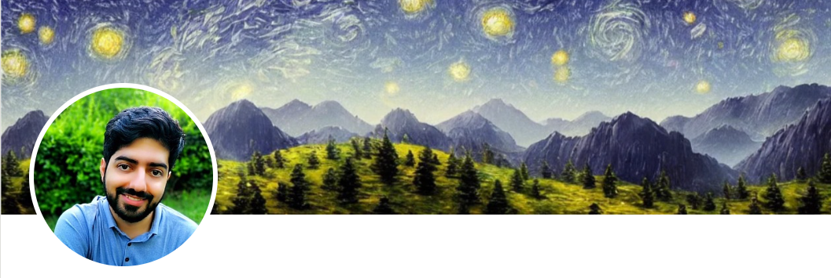
Contact me
Gmail: ImanKhaniJazani@gmail.com
LinkedIn: https://www.linkedin.com/in/ImanKhaniJazani/
Telegram: @IKJ1992

Slide 6
Short Presentations

Slide 7
Review the Last Lecture

Slide 8
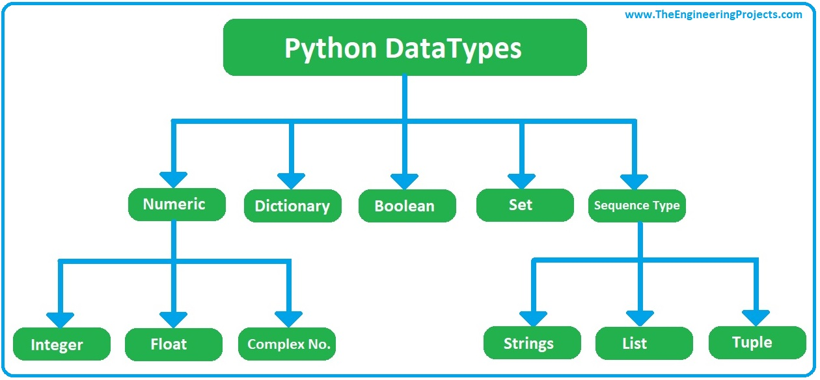
Python Data Structures

Slide 9
Big Picture about Algorithms

Slide 10
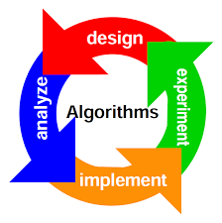
4 steps

Slide 11
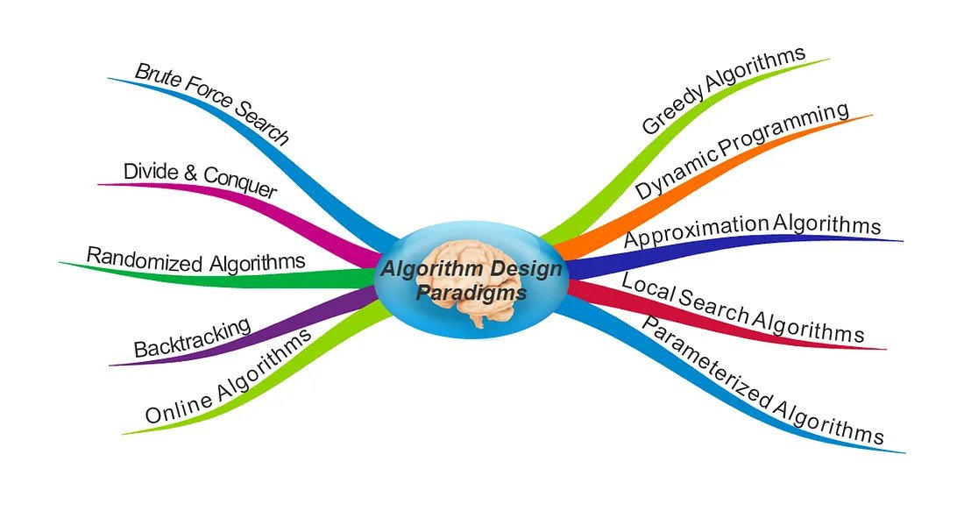
Algorithm design paradigms

Slide 12
Recursive methods in algorithms

Slide 13

Nested Functions?? YES! Nested (almost) Every things! Lest’s DO it.
Notes:
With return statement

Slide 14
Recursive mindset
We use, as humans, recursive methods in our life. When we want to ready for exam, Think about it…
What is your idea about example in real life?
Backtrack
Solve the base
Divide many times

Slide 15

Bowling game
where is recursion in it?

Slide 16
Let’s do it!

Slide 17
Can we solve with iterative approaches?

Slide 18
Can we solve with mathematical formulations?

Slide 19
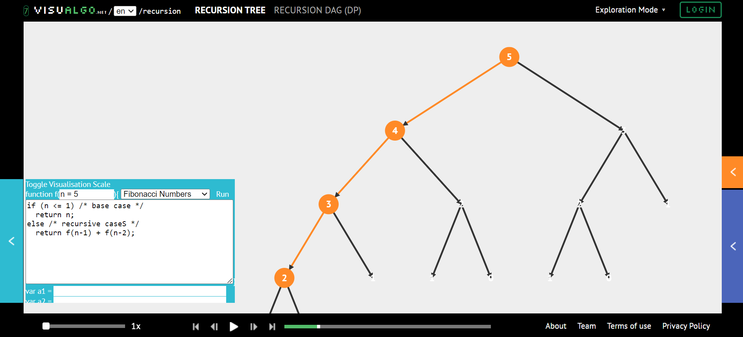
VISUALGO

Slide 20
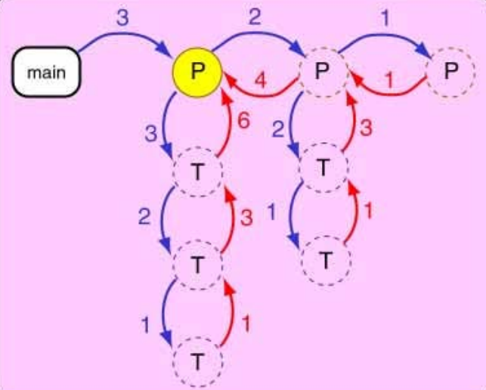
We can have more complex recursion!

Slide 21
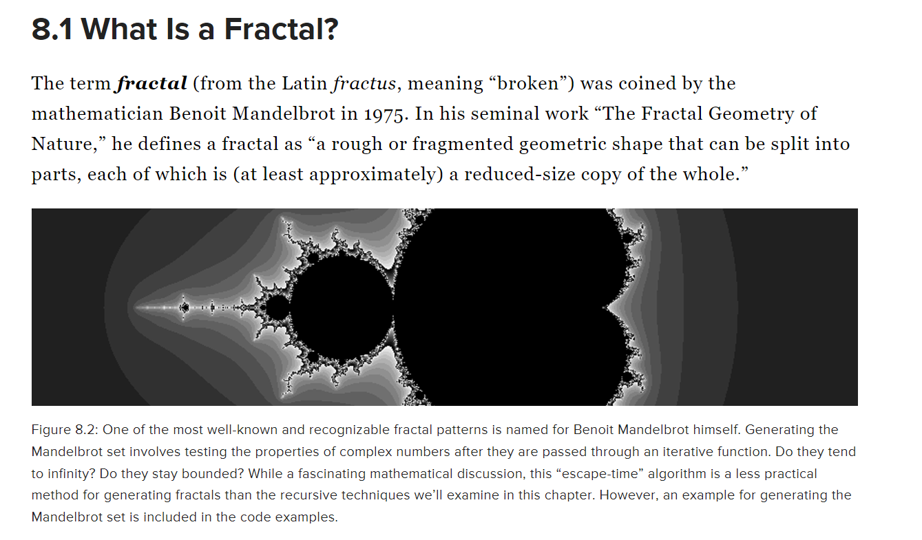
Fractals

Slide 22
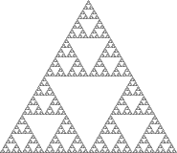
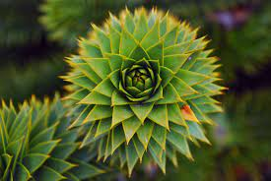
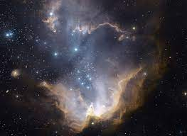
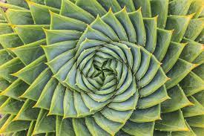
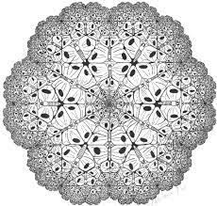

Some Examples in Universe!

Slide 23
For the next short presentation…
Explain Fractal application examples
how can we do it!?
Code simple one!

Slide 24
Application of Programming in the Digital Age!

Slide 25

SiteGPT
How can it answers our questions?!

Slide 26
Lecture Resources
https://natureofcode.com/book/chapter-8-fractals/
https://medium.com/@saiesh.prabhu17/algorithm-design-techniques-406922dd3047
https://github.com/tayllan/awesome-algorithms
https://visualgo.net/en/recursion
Thanks to Mehdi Allahyari for his comment❤

